Slide 1

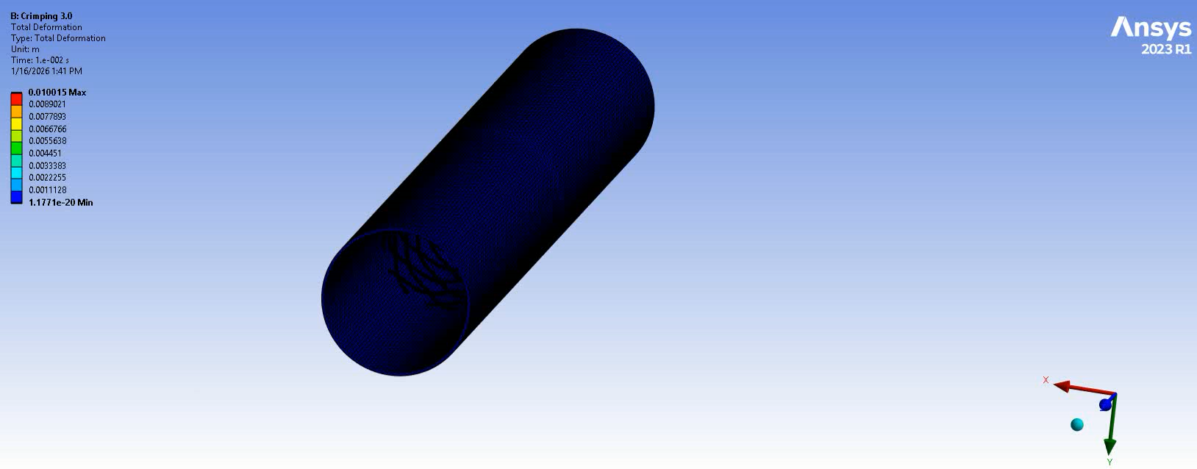
Progress of Simulation
Vid. Crimping of stent to deployment diameter

Slide 2
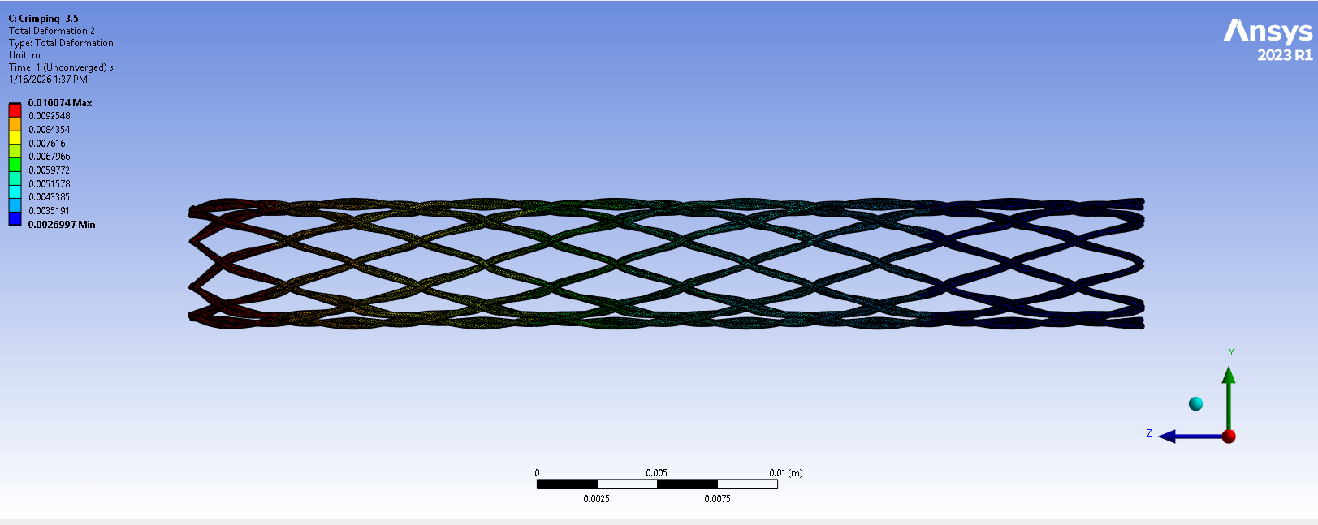
Progress of Simulation
Error in simulations
Poor-quality or distorted elements are not detected.
Asymmetric contact pairs make load transfer and stiffness become inconsistent, causing convergence instability.
Functional failure in contact pairs due to initial gaps between strut wires.
There exit a severe modelling error, with over-complex contact definition, poor contact geometry preparation and unsafe default contact parameters.
Fig. Non-convergence solution of the stent

